Slide 1
Development of master curricula for natural disasters risk management in Western Balkan countries
WP6.3 Promotional activity for student enrolment
WP6.4 Promotional activity for trainings
Milan Gocić
Vladan Nikolić
University of Niš
Third Project Management Committee meeting/ 8th March 2018
Project number: 573806-EPP-1-2016-1-RS-EPPKA2-CBHE-JP
"This project has been funded with support from the European Commission. This publication reflects the views only of the author, and the Commission cannot be held responsible for any use which may be made of the information contained therein"

Slide 2
Printing material
Development of master curricula for natural disasters risk management in Western Balkan countries
HEI | Leaflet with project results | Leaflet for training promotion in WB countries | Certificate for training participants (2 trainings x 30 participants) | Training material
UNI | 200 | 200 | 60 | 70
KPA | 200 | 200 | 60 | 70
UNID | 200 | 200 | 60 | 70
UPKM | 200 | 200 | 60 | 70
TCASU | 200 | 200 | 60 | 70
UNSA | 200 | 200 | 60 | 70
VSUP | 200 | 200 | 60 | 70
TOTAL | 1,400 | 1,400 | 420 | 490

Slide 3
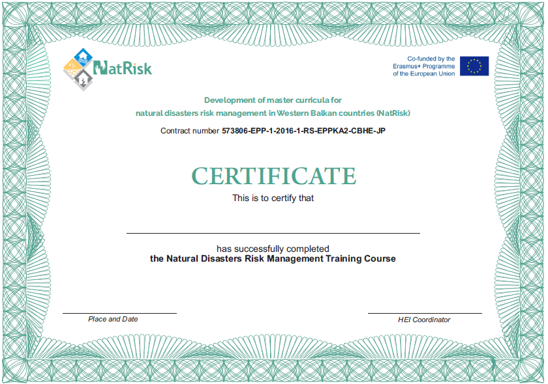
Certificate
Development of master curricula for natural disasters risk management in Western Balkan countries

Slide 4
Leaflet with project results
Development of master curricula for natural disasters risk management in Western Balkan countries

Slide 5
Leaflet with project results
Development of master curricula for natural disasters risk management in Western Balkan countries

Slide 6
Leaflet for training
Development of master curricula for natural disasters risk management in Western Balkan countries

Slide 7
Leaflet for training
Development of master curricula for natural disasters risk management in Western Balkan countries

Slide 8
Leaflet for training
Development of master curricula for natural disasters risk management in Western Balkan countries

Slide 9
Leaflet for training
Development of master curricula for natural disasters risk management in Western Balkan countries

Slide 10
To do list
Development of master curricula for natural disasters risk management in Western Balkan countries
Plan for LLL courses for professionals in the field of NDRM – COMPLETED
To consider the possibility of delivering multi-day courses to NDRM professionals in order to increase their impact and effectiveness
Organize round-tables or meetings with relevant stakeholders (red cross, fire brigades, police, emergency agencies, representatives of municipalities)

Slide 11
To do list
Development of master curricula for natural disasters risk management in Western Balkan countries
Each WB HEI should print 70 pieces of training’s material
2 examples per WB HEI in Serbian/Bosnian should be delivered to UNI
Each WB HEI should prepare subcontracts for printing in line with planned budget

Slide 12
To do list
Development of master curricula for natural disasters risk management in Western Balkan countries
UNI with WB HEIs will prepare promotinal materials - COMPLETED
UNI will print leaflets with project results and for training promotion and certificates - COMPLETED
Each WB HEI will receive 60 pieces of folders and pencils for training’s participants - COMPLETED
Each WB HEI should select trainers - COMPLETED

Slide 13
Leaflet for master curricula
Development of master curricula for natural disasters risk management in Western Balkan countries

Slide 14
Leaflet for master curricula
Development of master curricula for natural disasters risk management in Western Balkan countries

Slide 15
To do list
Development of master curricula for natural disasters risk management in Western Balkan countries
Each WB HEI should print leaflet for promotion master curricula (5000x) and brochure (20 pages, 500x) in line with the planned budget.
Organize info days or meetings with future students in secondary schools and promote master curricula using media (printed, on-line, TV or radio)

Slide 16
Development of master curricula for natural disasters risk management in Western Balkan countries
Sub-Contrating - Supporting documents
Invoices, subcontracts and bank statements Certified copy

